Slide 1
Physics-L2
Electromagnetism :
LC: 24 hours approx
EX: 24 hours approx
Teachers: Yannick Hinschberger and Gulyaz Najafova
Exams: 1 midterm (coeff : 1.5 ), 1 final (coeff : 2.5)
Practical Works
PW: 21 hours
Teachers: Yannick Hinschberger, Gulyaz Najafova and Alihuseyn Dovlatov
Exams: 1 report and 1 lab evaluation (coeff: 2)
Institut de Physique et Ingénierie

Slide 2
Physics-L2
Electromagnetism
Chapter 1: Electrostatics
Chapter 2: Magnetostatics
Chapter 3: Time-dependent regime-Induction phenomena
Chapter 4: Maxwell equations
Chapter 5: Dielectric media and applications
Chapter 6: Conducting media and applications
Chapter 7: Magnetic media and applications
Institut de Physique et Ingénierie

Slide 3
Physics-L2 Electromagnetism
Approximative program
week | Magistral lectures
1 | Electrostatics
2 | Electrostatics
3 | Electrostatics
4 | Electrostatics
5 | Magnetostatics
6 | Magnetostatics
7 | Induction
8 | Induction
9 | Maxwell equations
10 | Maxwell equations
11 | Dielectric media
12 | Dielectric / Metallic media
13 | Metallic Media
14 | Magnetic media
Chap 1: Electrostatics
Chap 2: Magnetostatics
Chap 3: Time-dependent regime-Induction phenomena
Chap 4: Maxwell equations
Chap 5: Dielectric media and applications
Chap 6: Conducting media and applications
Chap 7: Magnetic media and applications
Institut de Physique et Ingénierie

Slide 4
About Practical Works
week | Practical Work (SP2)
1
2
3
4 | Discovery of Oscilloscope
5
6
7
8
9
10
11
12
13
14
PW0: Oscilloscope
Same PW for all groups
PW1: Coaxial cable
PW2: Transformator
PW3: Sound Wave
PW4: Interference sound waves
PW5: Interference Optics
PW6: Electron canon
Institut de Physique et Ingénierie

Slide 5



Lectures Physics L2
Electromagnetism
Institut de Physique et Ingénierie

Slide 6
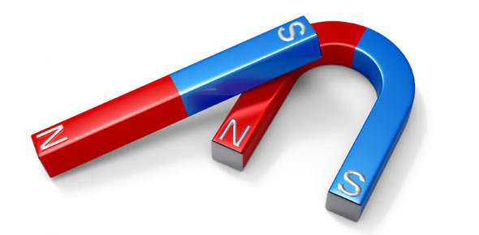
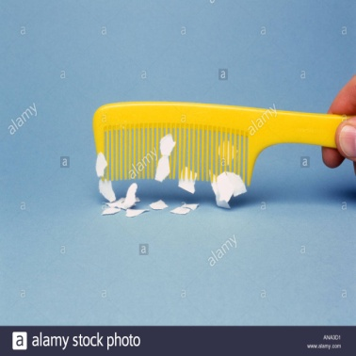
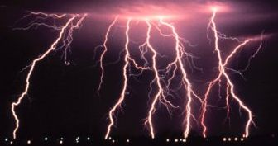
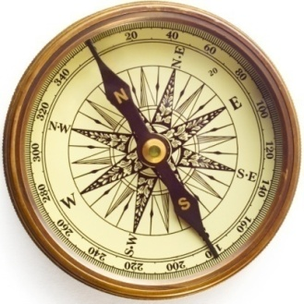
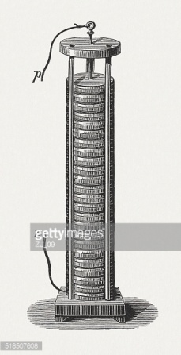
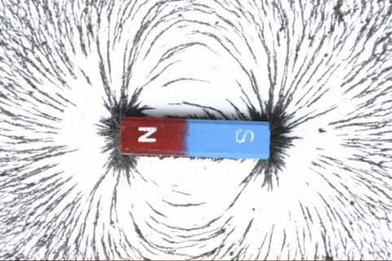
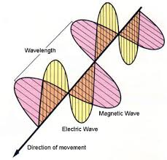
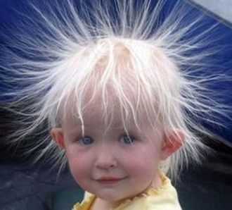
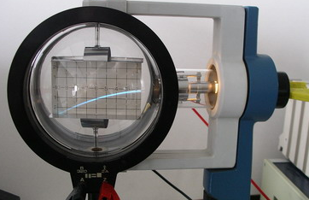
Electromagnetism
Institut de Physique et Ingénierie

Slide 7
Electricity
Electromagnetism
Static electricity
Optics
1785
Coulomb law
1855-1868:
Maxwell Theory
1896: Thomson
Discovery of Electron
Natural Magnet
Magnetism
Institut de Physique et Ingénierie

Slide 8
Electricity
Electromagnetism
Static electricity
Optics
1750: Franklin
Electric charges
+ and -
Geometric optics
1729: Gray
Insulator
conductor
Wave optics
1905: Einstein
Photon
1819:Oersted
Experience
1831:Faraday
induction
1785
Coulomb law
1799: Volta Battery
1820: Ampere
Eletrodynamic
1855-1868:
Maxwell Theory
1896: Thomson
Discovery of Electron
Natural Magnet
1886: Hertz Emission of
Electromagnetic waves
Magnetism
1600: Gilbert
Earth magnetism
Institut de Physique et Ingénierie

Slide 9
Brief historical overview
Electricity
Electricity
Electromagnetism
Static electricity
1729: Gray
Insulator
conductor
1750: Franklin
Electric charges
+ and -
1785
Coulomb law
1799: Volta Battery
Magnetism
Institut de Physique et Ingénierie

Slide 10
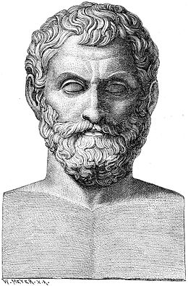
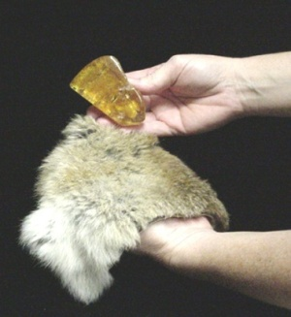
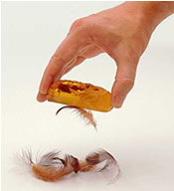
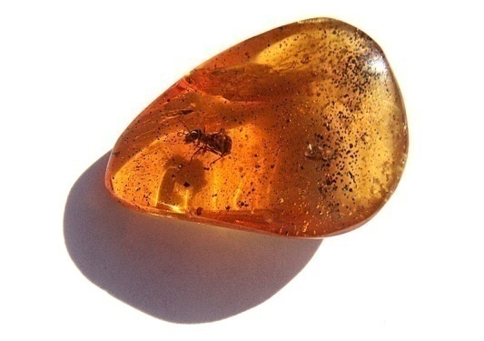
Brief historical overview
Electricity
Static Electricity
Electrisation by friction
Amber
From ancient greek:
ἤλεκτρον elektron:
Old greek
hand
Thales
625-547 BC
After rubing amber with, it can attract light objects
Institut de Physique et Ingénierie

Slide 11
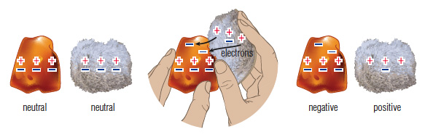
Brief historical overview
Electricity
Static Electricity
Electrisation by friction
Amber
From ancient greek:
ἤλεκτρον elektron:
Old greek
hand
Thales
625-547 BC
After rubing amber with, it can attract light objects
M
Modern explanation
Institut de Physique et Ingénierie

Slide 12
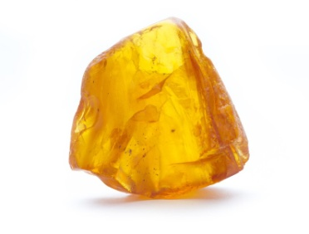
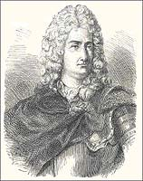
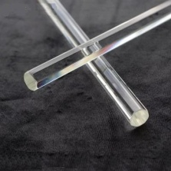
Brief historical overview
Electricity
Two types of electricity
Electricity is seen as a fluid
Resineous electricity:
obtained after friction with amber
Vitreous electricity:
obtained after friction with glass
Charles Du Fay
1698-1739
Institut de Physique et Ingénierie

Slide 13
Brief historical overview
Electricity
Two types of electricity
Electricity is seen as a fluid
Resineous electricity:
obtained after friction with amber
Vitreous electricity:
obtained after friction with glass
Charles Du Fay
1698-1739
2 pendulums
rubbed with amber
REPULSION
2 pendulums
rubbed with glass
REPULSION
1 pendulum rubbed with glass and
1 pendulum rubbed with amber
ATTRACTION
Institut de Physique et Ingénierie

Slide 14
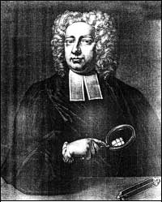
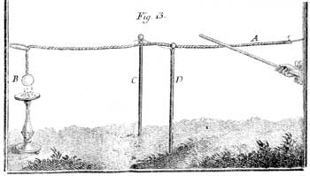
Brief historical overview
Electricity
Propagation of electricity: conductor-insulator
One can propagate electricity
existence of materials that propagate electric fluids
and others not.
Electrisation by contact
with a glass stick
Stephen Gray
1666-1736
The electric fluid propagates until the sphere because it attracts little papers
Institut de Physique et Ingénierie

Slide 15
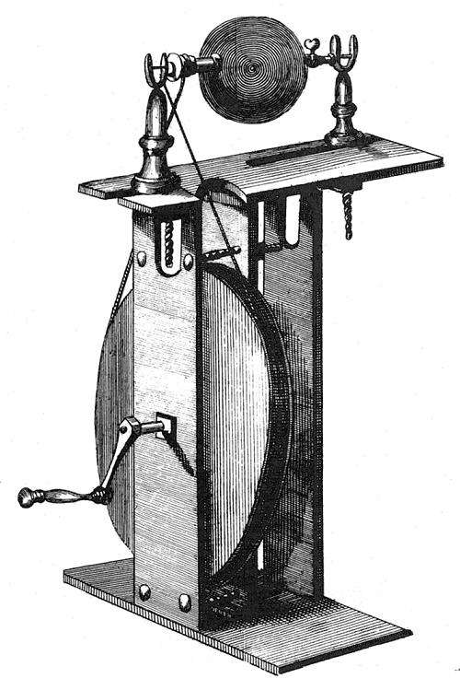
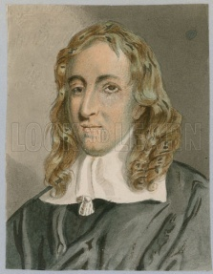
Brief historical overview
Electricity
Eletrostatic devices
1706
Electrisation by contact with
a rotating sulfur sphere
Francis Hauksbee
1666-1713
Institut de Physique et Ingénierie

Slide 16
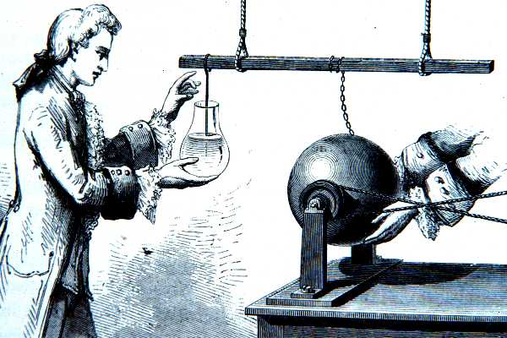
Brief historical overview
Electricity
Eletrostatic devices
1746: University of Leiden
Pieter van Musschenbroek (1692-1761)
1706
Electrisation by contact with
a rotating sulfur sphere
Leiden Jar (bottle)….first capacitor
Deliver electric discharge
Francis Hauksbee
1666-1713
Institut de Physique et Ingénierie

Slide 17
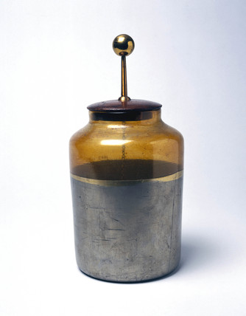
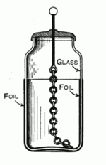
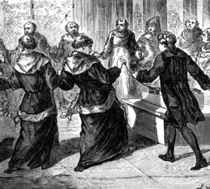
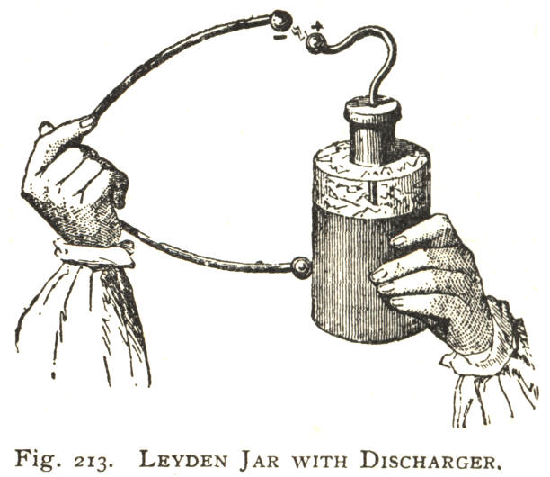
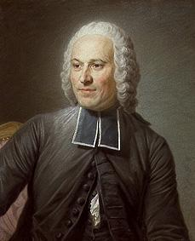
Brief historical overview
Electricity
Eletrostatic devices
1746: University of Leiden
Pieter van Musschenbroek (1692-1761)
1706
Electrisation by contact with
a rotating sulfur sphere
Leiden Jar (bottle)….first capacitor
Deliver electric discharge
Francis Hauksbee
1666-1713
Jean-Antoine Nollet
1700-1770
Institut de Physique et Ingénierie

Slide 18
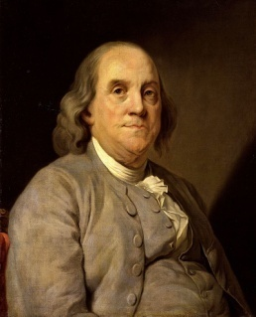
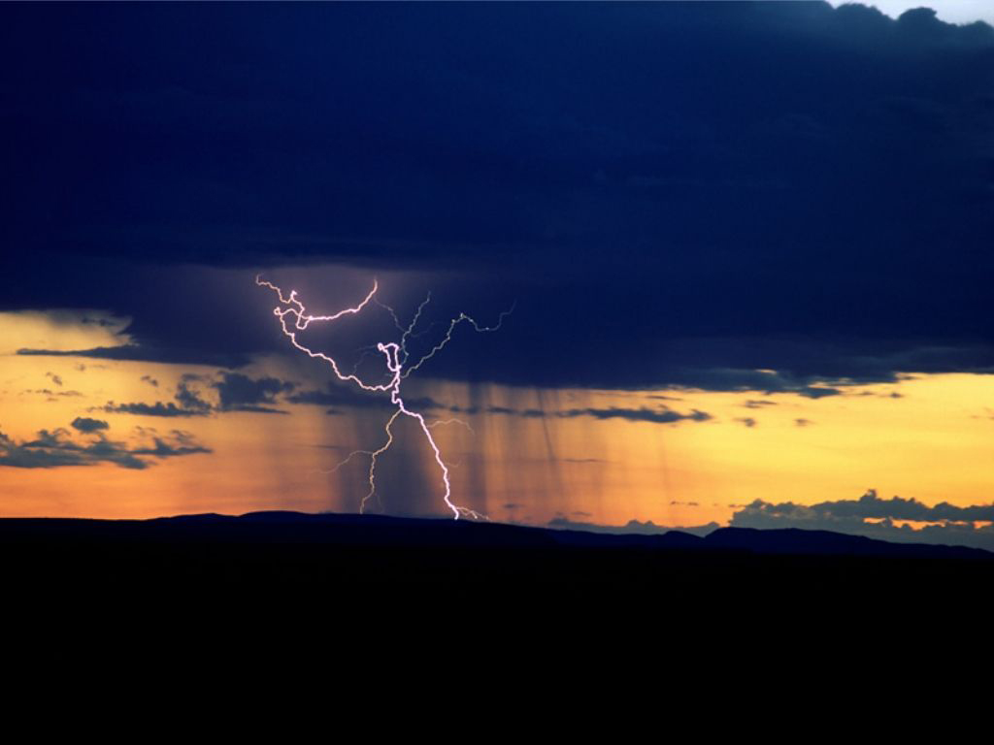
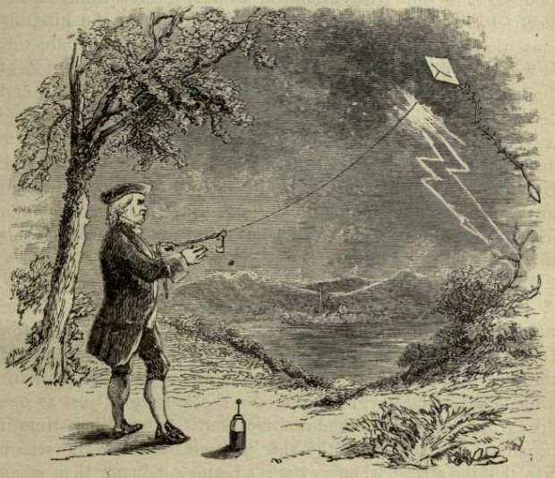
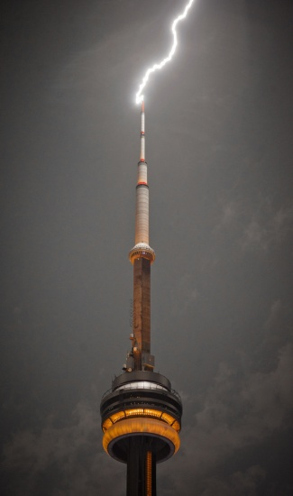
Brief historical overview
Electricity
Negative and Postive charges
Vitreous electricity and resineous electricity represent the same fluid at different pressures, the circulation of electricity put the two states at equilibrium.
Benjamin Franklin
1706-1790
- - - - - - - - -
- - - - - - - - -
+
+
+
+ + + + + + +
+ + + + + + +
Institut de Physique et Ingénierie

Slide 19
Brief historical overview
Electricity
Negative and Postive charges
Vitreous electricity and resineous electricity represent the same fluid at different pressures, the circulation of electricity put the two states at equilibrium.
Benjamin Franklin
1706-1790
- - - - - - - - -
- - - - - - - - -
+
+
+
+ + + + + + +
+ + + + + + +
Institut de Physique et Ingénierie

Slide 20
Brief historical overview
Electricity
Negative and Postive charges
Vitreous electricity and resineous electricity represent the same fluid at different pressures, the circulation of electricity put the two states at equilibrium.
Benjamin Franklin
1706-1790
- - - - - - - - -
- - - - - - - - -
+
+
+
+ + + + + + +
+ + + + + + +
Lightning rod
Institut de Physique et Ingénierie

Slide 21
Brief historical overview
Electricity
Negative and Postive charges
Vitreous electricity and resineous electricity represent the same fluid at different pressures, the circulation of electricity put the two states at equilibrium.
Benjamin Franklin
1706-1790
- - - - - - - - -
- - - - - - - - -
+
+
+
+ + + + + + +
+ + + + + + +
Charge conservation
Phenomena acting at distance
Explanation of Leiden jar phenomena
Lightning rod
Institut de Physique et Ingénierie

Slide 22
Brief historical overview
Electricity
Interpretation of Leyden Jar
Internal
Metallic
Foil
External
Metallic
Foil
Metallic Chain propagates electric perturbation to the internal foil
+
+
+
+
-
-
-
-
-
Glass: Insulating
space between
the two foils
Institut de Physique et Ingénierie

Slide 23
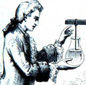

Brief historical overview
Electricity
Interpretation of Leyden Jar
Internal
Metallic
Foil
External
Metallic
Foil
Metallic Chain propagates electric perturbation to the internal foil
+
+
+
+
-
-
-
-
-
Glass: Insulating
space between
the two foils
Possibility to close the circuit and to induce an electric discharge !!
Institut de Physique et Ingénierie

Slide 24
Brief historical overview
Electricity
Voltage u_{C}
Metallic wall with
Positive charge +q
+++++++
-----
Metallic wall with
negative charge -q
d
S
Insulating part
Institut de Physique et Ingénierie

Slide 25
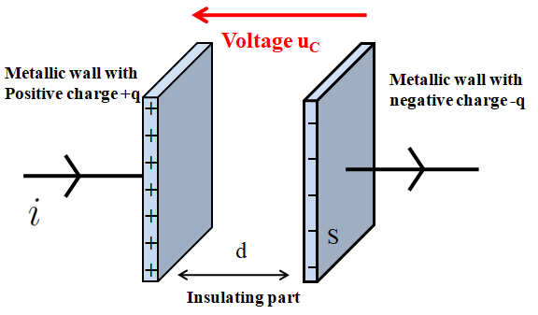
Brief historical overview
Electricity
Quick Modern description: Principle of a capacitor
Can accumulate and stock electric charges:
+
-
Electric symbol
Institut de Physique et Ingénierie

Slide 26
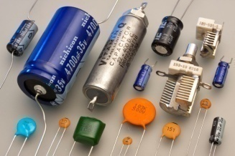
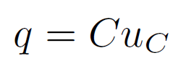
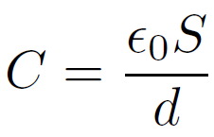
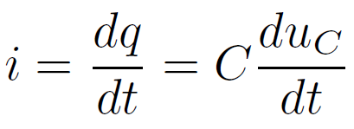
Brief historical overview
Electricity
Quick Modern description: Principle of a capacitor
Can accumulate and stock electric charges:
+
-
Electric symbol
Described by its Capacitance C (or capacity) in Farad (Coulomb/Volt):
(if insulating part is the vaccum)
C: from µF to pF
Relation between current and voltage
Institut de Physique et Ingénierie

Slide 27
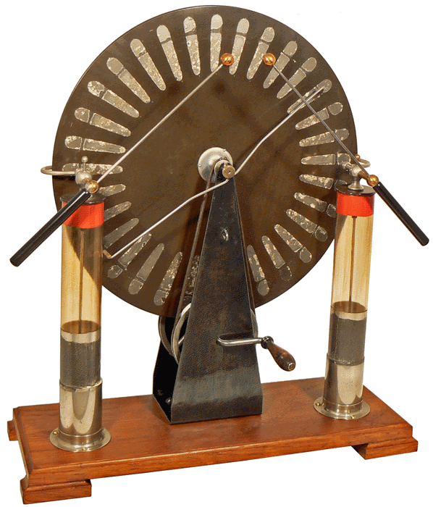
Brief historical overview
Electricity
Wimshurst Machine (1882)
Institut de Physique et Ingénierie

Slide 28
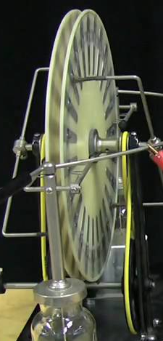
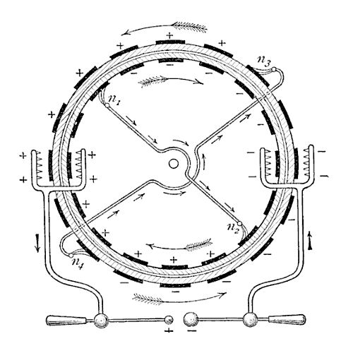
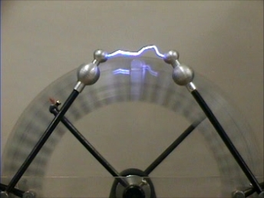
Brief historical overview
Electricity
Wimshurst Machine (1882)
Two wheels rotating in opposite direction in contact with metallic brushes.
Creation of negative charge induces apparition of a a positive charge on the other side of the brush
By the weels rotation, charges are transported and collected
When electric charges become to high: lightning
You Might watch
https://www.youtube.com/watch?v=Zilvl9tS0Og
Institut de Physique et Ingénierie

Slide 29
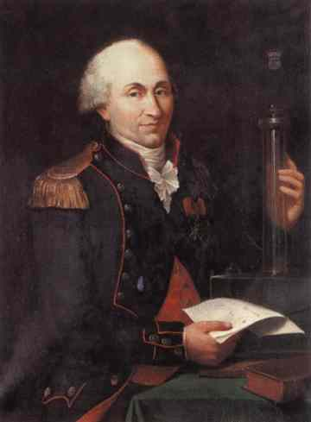
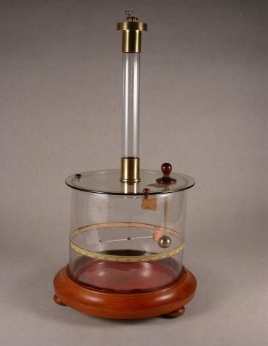
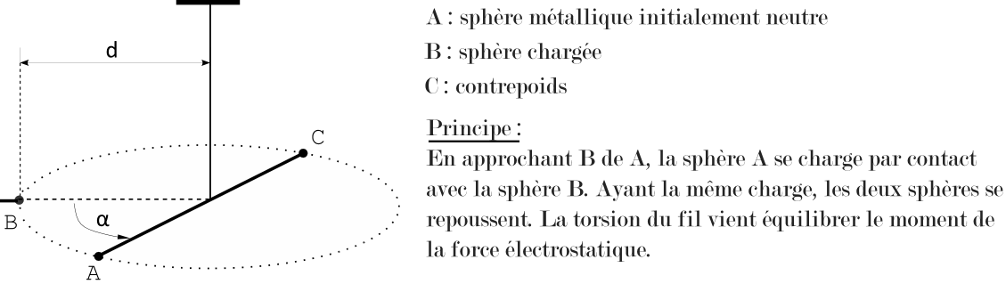
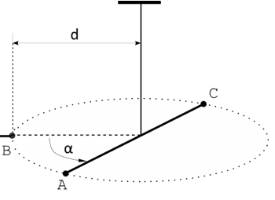
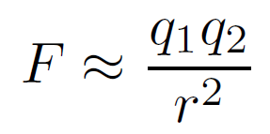
Brief historical overview
Electricity
Parameters that influence the electric force
Coulomb balance: device composed with a torsion balance able
to measure weak electric forces.
Charles Coulomb
1736-1806
Repulsion of two spheres after electrisation
of neutral sphere A by charged sphere B.
Coulomb: unit of electric charge
Institut de Physique et Ingénierie

Slide 30
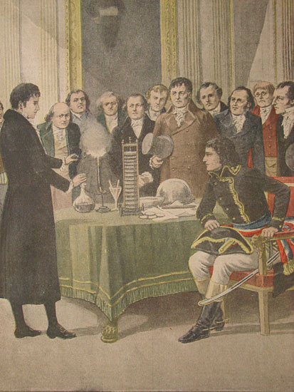
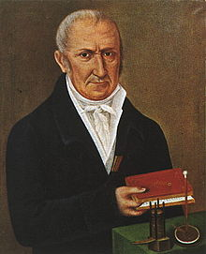
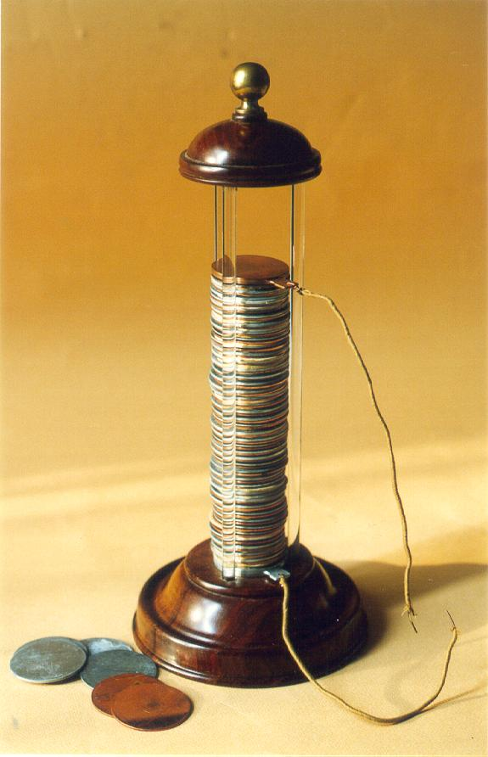
Brief historical overview
Electricity
First Generator
1800: Volta Battery: can deliver electricity without interuption, not only by a discharge.
Unit of electric tension: Volt
Alessandro Volta
1745-1827
Institut de Physique et Ingénierie

Slide 31
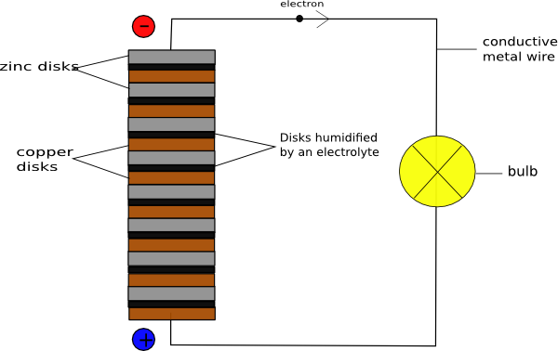
Brief historical overview
Electricity
First Generator
1800: Volta Battery: can deliver electricity without interuption, not only by a discharge.
Unit of electric tension: Volt
Alessandro Volta
1745-1827
Exemple of voltaic battery (cell)
Zinc disc
Salty solution
electrolyte
Copper disc
Institut de Physique et Ingénierie

Slide 32

Brief historical overview
Electricity
First Generator
1800: Volta Battery: can deliver electricity without interuption, not only by a discharge.
Unit of electric tension: Volt
Alessandro Volta
1745-1827
Exemple of voltaic battery (cell)
Zinc disc
Chemical explanation: redox reactions
Salty solution
electrolyte
Copper disc
Liberation of two
Electrons
Oxidation of zinc
Creation of hydrogen gas
Reduction of two
Water molecules
Institut de Physique et Ingénierie

Slide 33






Brief historical overview
Electricity
A famous pedagogic example: Daniell Cell (1836)
Field of Electrochemistry
Voltmeter gives ≈ 1,1 Volt
John. F. Daniell
1790-1845
V
+
Institut de Physique et Ingénierie

Slide 34








Brief historical overview
Electricity
Further development : birth of electric circuits…and electric civilisation
Georg Ohm
1789-1854
Notion of electric current Voltage –Tension
André-M. Ampère
1775-1836
Gustav Kirchhoff
1824-1887
Current and
voltage laws
Resistance
Nikola Tesla
1856-1943
Use of alternative current
After discovery of induction…
Thomas Edison
1847-1931
Incandescent light bulb
Institut de Physique et Ingénierie

Slide 35
Brief historical overview
Magnetism
Electricity
Electromagnetism
Static electricity
1729: Gray
Insulator
conductor
1750: Franklin
Electric charges
+ and -
1785
Coulomb law
1799: Volta Battery
Natural Magnet
Magnetism
1600: Gilbert
Earth magnetism
Institut de Physique et Ingénierie

Slide 36


Brief historical overview
Magnetism
Magnet
Magnetite (Iron oxide) has attractive or
Repulsive properties (known since antiquity)
Institut de Physique et Ingénierie

Slide 37


Brief historical overview
Magnetism
Magnet
Defining poles: North and South poles
Magnetite (Iron oxide) has attractive or
Repulsive properties (known since antiqity)
opposite poles attract
same poles repel
Institut de Physique et Ingénierie

Slide 38


Brief historical overview
Magnetism
Magnet
Defining poles: North and South poles
Magnetite (Iron oxide) has attractive or
Repulsive properties (known since antiquity)
opposite poles attract
same poles repel
Existence of a natural geographic orientation….North
Who invented the magnetic compass ?
Each civilization pretends to did it…
Institut de Physique et Ingénierie

Slide 39




Brief historical overview
Magnetism
Magnetic orientation
With small iron filings near magnets one can see… lines…
Iron
fillings
Institut de Physique et Ingénierie

Slide 40



Brief historical overview
Magnetism
Magnetic orientation
With small iron filings near magnets one can see… lines…
Iron
fillings
Earth Magnetism
Geographic North is a magnetic south
William Gilbert
1544-1603
The magnetic compass should react in
the same way than with a magnet
Institut de Physique et Ingénierie

Slide 41
Brief historical overview
Electromagnetism
Electricity
Electromagnetism
Static electricity
1729: Gray
Insulator
conductor
1750: Franklin
Electric charges
+ and -
1819:Oersted
Experience
1785
Coulomb law
1799: Volta Battery
Natural Magnet
Magnetism
1600: Gilbert
Earth magnetism
Institut de Physique et Ingénierie

Slide 42


Brief historical overview
Electromagnetism
1819: A Link between electricity and magnetism
Electricity induces motion of magnetic compass
Hans. C Oersted
1777-1851
Institut de Physique et Ingénierie

Slide 43

Brief historical overview
Electromagnetism
1819: A Link between electricity and magnetism
Electricity induces motion of magnetic compass
1
2
Hans. C Oersted
1777-1851
1. No conduction: initial orientation of magnetic compass
2. Circulation of electricity modifies the orientation of magnetic compass.
Institut de Physique et Ingénierie

Slide 44
Brief historical overview
Electromagnetism
1819: A Link between electricity and magnetism
Electricity induces motion of magnetic compass
1
2
Hans. C Oersted
1777-1851
1. No conduction: initial orientation of magnetic compass
2. Circulation of electricity modifies the orientation of magnetic compass.
Electricity can have similar action
than a natural magnet
Institut de Physique et Ingénierie

Slide 45
Brief historical overview
Electromagnetism
Eletrodynamic theory
Interpretation of Oersted Experiment
Electric current creates magnetic action
- Notion of electric current I: motion of microscopic electric charges
- Direction of the current I influences direction of magnetic compass
André-M. Ampère
1775-1836
I=0
I>0
I<0
N
S
S
N
N
S
Institut de Physique et Ingénierie

Slide 46


Brief historical overview
Electromagnetism
Eletrodynamic theory
Geometric analysis: Right-hand rule
Bonhomme d’Ampère
Institut de Physique et Ingénierie

Slide 47




Brief historical overview
Electromagnetism
Eletrodynamic theory
Geometric analysis: Right-hand rule
Bonhomme d’Ampère
Biot-Savart Law
J.B Biot
1774-1862
Felix Savart
1791-1841
µ₀=4π10⁻⁷ H/m
Magnetic permeability
Institut de Physique et Ingénierie

Slide 48
Brief historical overview
Electromagnetism
Further discovered phenomena
Interaction between two electric currents
Definition of Ampere:
Unit of electric current:
1 A= current needed to have a lineic force of 2*10⁷ N/m between two infinite wires separated from one meter.
I₁
I₂
I₁
I₂
I₁=I₂=0
Initial position
I₁>0 and I₂<0
Or I₁<0 and I₂>0
ATTRACTION
I₁>0 and I₂>0
Or I₁<0 and I₂<0
REPULSION
Institut de Physique et Ingénierie

Slide 49



Brief historical overview
Electromagnetism
Further discovered phenomena
Interaction between two electric currents
Definition of Ampere:
Unit of electric current:
1 A= current needed to have a lineic force of 2*10⁷ N/m between two infinite wires separated from one meter.
I₁
I₂
I₁
I₂
I₁=I₂=0
Initial position
I₁>0 and I₂<0
Or I₁<0 and I₂>0
ATTRACTION
I₁>0 and I₂>0
Or I₁<0 and I₂<0
REPULSION
Magnetic field acts also on other electric current
Laplace Force
Institut de Physique et Ingénierie

Slide 50



Brief historical overview
Electromagnetism
Further discovered phenomena
Important device: Solenoid- or self or magnetic coil
1 loop of current
Many loops of current
Creation of magnetic field inside the solenoide
Similar properties than
Ones given by natural magnet
Institut de Physique et Ingénierie

Slide 51


Brief historical overview
Electromagnetism
1831: Magnetism can induce electricity
Important contribution
Chemistry (electrolysis)
Notion of vectors fields
Electromagnetic Induction
Michael Faraday
1791-1867
Institut de Physique et Ingénierie

Slide 52



Brief historical overview
Electromagnetism
1831: Magnetism can induce electricity
Important contribution
Chemistry (electrolysis)
Notion of vectors fields
Electromagnetic Induction
Michael Faraday
1791-1867
I
G
A magnetic coil that produces
a magnetic field
A magnetic coil related to
a voltmeter.
Institut de Physique et Ingénierie

Slide 53

Brief historical overview
Electromagnetism
1831: Magnetism can induce electricity
Important contribution
Chemistry (electrolysis)
Notion of vectors fields
Electromagnetic Induction
0
Michael Faraday
1791-1867
v
We move the first coil
close to the second
and a voltage appears
during the motion !
I
G
0
If motion is faster, voltage
In the second coil is higher !
Institut de Physique et Ingénierie

Slide 54


Brief historical overview
Electromagnetism
1831: Magnetism can induce electricity
Important contribution
Chemistry (electrolysis)
Notion of vectors fields
Electromagnetic Induction
It works also with a magnet
Motion of magnet inside the self…
Michael Faraday
1791-1867
…generates electric tension !!!
Institut de Physique et Ingénierie

Slide 55



Brief historical overview
Electromagnetism
1831: Magnetism can induce electricity
Important contribution
Chemistry (electrolysis)
Notion of vectors fields
Electromagnetic Induction
It works also with a magnet
Motion of magnet inside the self…
Michael Faraday
1791-1867
…generates electric tension !!!
Induction:
Time-dependent modification of magnetic field through the loop surface generates a voltage
Institut de Physique et Ingénierie

Slide 56




Brief historical overview
Electromagnetism
Examples or applications
1832: Self-induction (Henry):
induction created by the magnetic field
created by the current it self
Dynamo
Institut de Physique et Ingénierie

Slide 57






Brief historical overview
Electromagnetism
Examples or applications
1832: Self-induction (Henry):
induction created by the magnetic field
created by the current it self
Dynamo
Transformator: modifying voltage
Continous current motor
Institut de Physique et Ingénierie

Slide 58
Brief historical overview
Electromagnetism
Electricity
Electromagnetism
Static electricity
Optics
1750: Franklin
Electric charges
+ and -
Geometric optics
1729: Gray
Insulator
conductor
Wave optics
1819:Oersted
Experience
1831:Faraday
induction
1785
Coulomb law
1799: Volta Battery
1820: Ampere
Eletrodynamic
1855-1868:
Maxwell Theory
Natural Magnet
Magnetism
1600: Gilbert
Earth magnetism
Institut de Physique et Ingénierie

Slide 59

Brief historical overview
Electromagnetism
The synthesis: 1855-1864
Mathemathical description (vectorial theory) that explains all the electromagnetic phenomena.
Dynamic theory that makes the relations between the fields (electric and magnetic fields) and the sources (charges and currents)
Electric and magnetic fields are waves propagating at the speed of the light c (connexion with optics).
James C. Maxwell
1831-1879
Institut de Physique et Ingénierie

Slide 60




Brief historical overview
Electromagnetism
The synthesis: 1855-1864
Mathemathical description (vectorial theory) that explains all the electromagnetic phenomena.
Dynamic theory that makes the relations between the fields (electric and magnetic fields) and the sources (charges and current)
Electric and magnetic fields are waves propagating at the speed of the light c (connexion with optics).
James C. Maxwell
1831-1879
This theory is known today as Maxwell’s equations
Institut de Physique et Ingénierie

Slide 61







Brief historical overview
Electromagnetism
The synthesis: 1855-1864
Will be seen in two years during Electromagnetic lectures
Each equation traduces a vectorial situation
Maxwell-Gauss
NO magnetic charge
Maxwell-Poisson
Coulomb Law
James C. Maxwell
1831-1879
Maxwell-Ampere
Biot-Savart law
Maxwell-Faraday
Induction phenomena
Not seen yet
Institut de Physique et Ingénierie

Slide 62


Brief historical overview
Electromagnetism
The synthesis: 1855-1864
Connection with Optics ?
Light is known to be a wave.
Maxwell predicted that Electric and Magnetic field are waves
propagating at the speed of the light c !
James C. Maxwell
1831-1879
From Maxwell equations one can obtain a 3D wave equation
Propagation of E-M waves (in the vaccum)
Institut de Physique et Ingénierie

Slide 63



Brief historical overview
Electromagnetism
Optics: geometric optics and wave optics
Institut de Physique et Ingénierie

Slide 64




Brief historical overview
Electromagnetism
Optics: geometric optics and wave optics
Interferences Polarisation
Institut de Physique et Ingénierie

Slide 65


Brief historical overview
Electromagnetism
Further key-events
1887: Experimental Proof of Maxwell Theory by Heinrich Rudolf Hertz. Emission and reception of electromagnetic waves !
Heinrich. R Hertz
1857-1894
Institut de Physique et Ingénierie

Slide 66







Brief historical overview
Electromagnetism
Further key-events
1887: Experimental Proof of Maxwell Theory by Heinrich Rudolf Hertz. Emission and reception of electromagnetic waves !
Heinrich. R Hertz
1857-1894
Institut de Physique et Ingénierie

Slide 67



Brief historical overview
Electromagnetism
Further key-events
1897: Discovery of the electron by
Thompson (1856-1940)
1905: Albert Einstein explains photoelectric effect (discovered by Hertz).
Light is also a particule: photon of energy E=hν where is the frequency of the light.
E=hν
Institut de Physique et Ingénierie

Slide 68


Brief historical overview
Electromagnetism
Further key-events
1897: Discovery of the electron by
Thompson (1856-1940)
1905: Albert Einstein explains photoelectric effect (discovered by Hertz).
Light is also a particule: photon of energy E=hν where is the frequency of the light.
E=hν
1911: Discovery of the nucleus by Ernest Rutherford
Institut de Physique et Ingénierie

Slide 69
Electricity
Electromagnetism
Static electricity
Optics
1750: Franklin
Electric charges
+ and -
Geometric optics
1729: Gray
Insulator
conductor
Wave optics
1905: Einstein
Photon
1819:Oersted
Experience
1831:Faraday
induction
1785
Coulomb law
1799: Volta Battery
1820: Ampere
Eletrodynamic
1855-1868:
Maxwell Theory
1896: Thomson
Discovery of Electron
Natural Magnet
1886: Hertz Emission of
Electromagnetic waves
Magnetism
1600: Gilbert
Earth magnetism
Institut de Physique et Ingénierie

